Slide 1
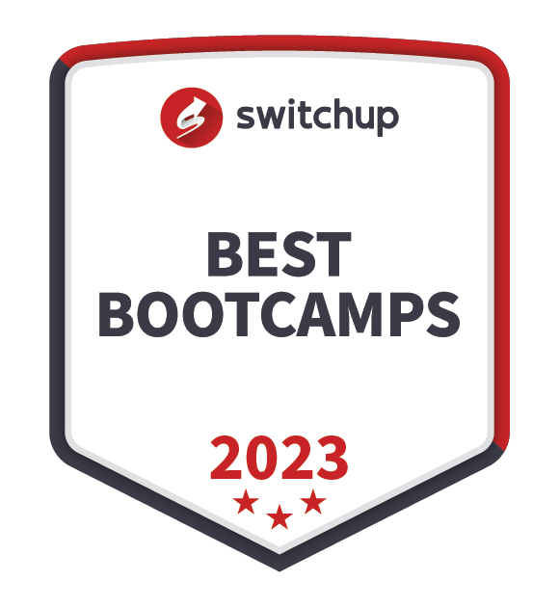

//Developers_Institute_
TLV Coding Bootcamp
CLV Project
Developers Institute ranked for Best Coding Bootcamp Worldwide for 2023
Azerbaijan 🇦🇿- México 🇲🇽 - Cameroon 🇨🇲 - Senegal 🇸🇳 - Burkina Faso 🇧🇫 - Mali 🇲🇱 - Ghana 🇬🇭 - Togo 🇹🇬 - Mauritius 🇲🇺 - Morocco 🇲🇦 - India 🇮🇳 - Georgia 🇬🇪 - Israël 🇮🇱

Slide 2
CLV Project: Analyzing and Predicting Customer Lifetime Value (CLV)
Objective:
Analyze customer behavior and predict Customer Lifetime Value (CLV) by
leveraging simulated data based on real-world trends,
enhanced by data scraped from Trustpilot and Amazon.
Kirill Zaiakin
January 2025, Developers Institute TLV Coding Bootcamp

Slide 3
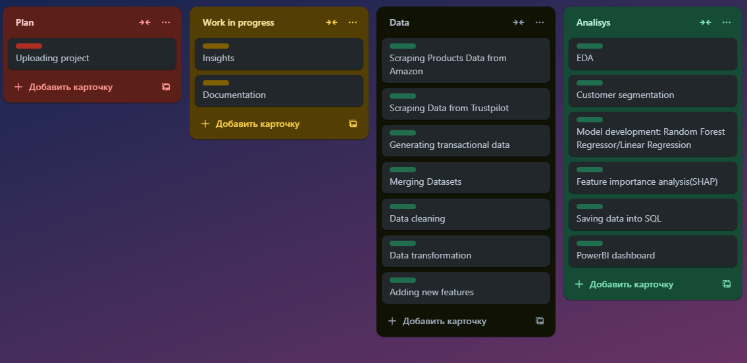
Feature list

Slide 4
Stack
Languages:
Python, SQL.
Libraries and Frameworks:
Pandas, NumPy, Faker, BeautifulSoup, Matplotlib & Seaborn, Plotly, Scikit-learn, SHAP.
Tools:
Power BI, VScode, Jupyter Notebook, Google Colab. Parsehub, Apify.
Other Technologies:
Microsoft Excel, PowerPoint.

Slide 5
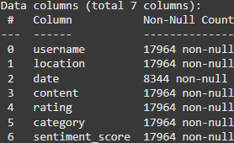
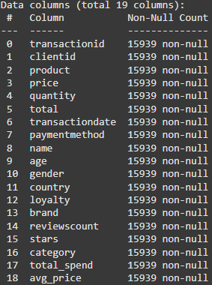
Data collection
Datasets used in this project:
1. Amazon products dataset
Categories: grocery, health, electronics, home
Data structure:
Product title, Product price, Rating (1-5 stars), Amount of reviews, Business name, Category, Subcategory
2. Trustpilot reviews dataset
Categories: grocery, health, electronics, home
high-rated businesses (4.5+ stars) with large review counts (>3,000 reviews)
mid-rated businesses (3.5–4.5 stars) with moderate review counts (1000-3000 reviews)
lower-rated businesses (<3.5 stars) with smaller review counts (<1000 reviews)
Data structure:
User name, Rating, Date, Location, Review Text
3. Simulated customer and transactions data
Data structure:
Transaction ID, Category, Product, Price, Quantity, Total, Transaction Date, Payment Method,
Client ID, Name, Age, Gender, Country, Loyalty

Slide 6
Data Cleaning and Preparation
Raw data from Amazon, Trustpilot, Synthetic Transactions and Clients
Merging
Datasets
Handling missing values and duplicates
Adding new features
Calculating RFM metrics
EDA
Cleaned and prepared dataset
SQL
Database
Customer Segmentation
Model Development
Feature Importance Analysis
PowerBI Dashboard

Slide 7
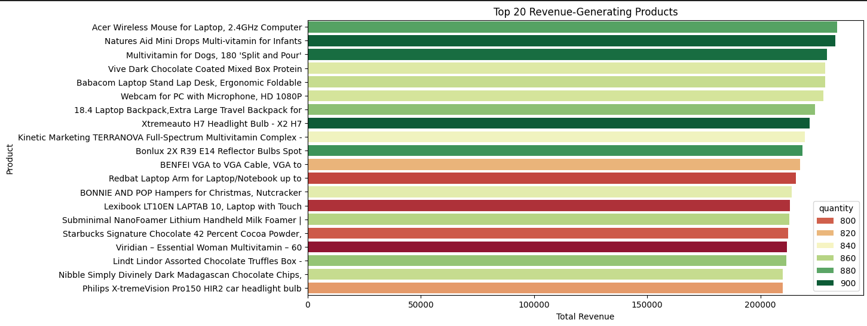
EDA Key Findings

Slide 8
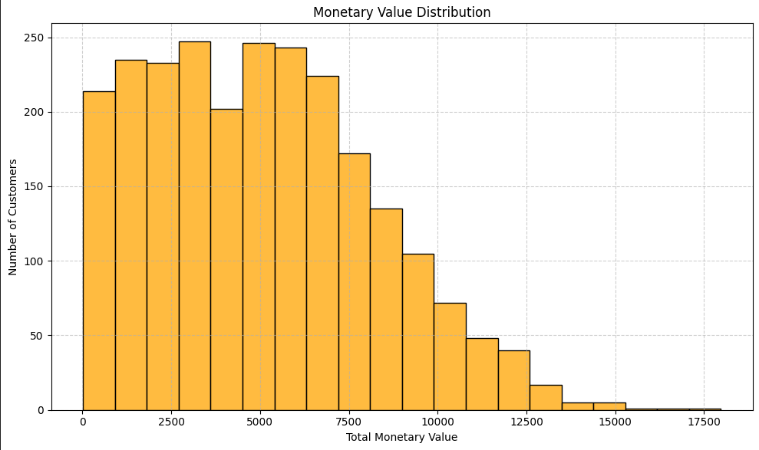
EDA Key Findings

Slide 9
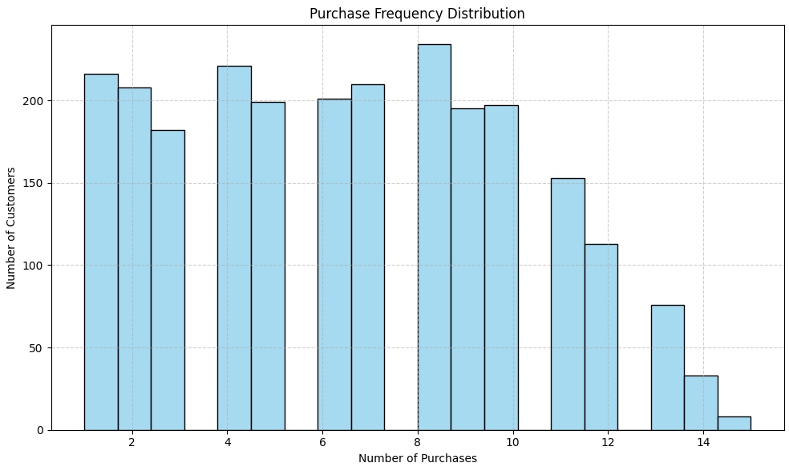
EDA Key Findings

Slide 10
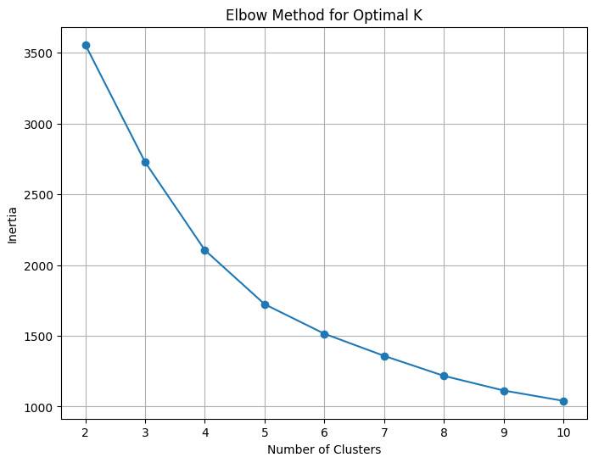
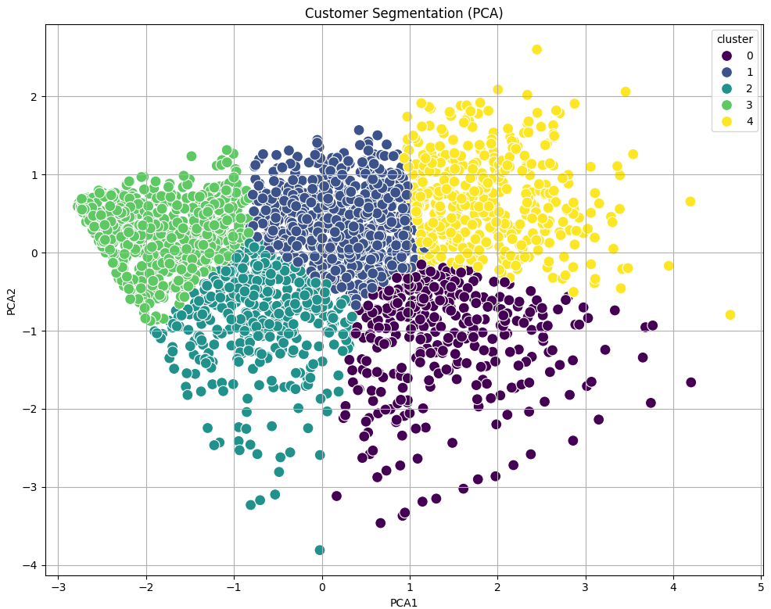
Customer Segmentation
0: "Loyal High-Value Customers“ - High frequency and high monetary value
1: "Loyal Customers“ - Moderate frequency, high monetary value
2: "Moderate Spend, Low Frequency“ - Moderate monetary value, low frequency, low recency
3: "New Customers“ - High recency, low frequency, low monetary value
4: "Loyal High-Value Customers" - High frequency, very high monetary value, high recency

Slide 11
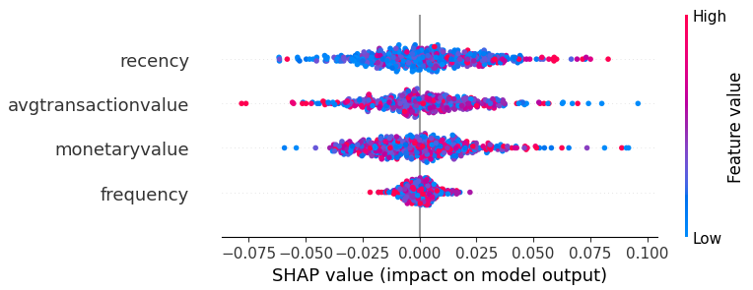
Prediction model results overview
Recency and average transaction value have the greatest impact on the prediction.
A positive SHAP value indicates that the recency and average transaction pushed the prediction higher if features are higher, while a negative value indicates that the feature pushed the prediction lower when features are lower.
Also we can see high values in recency on the right side and low on the left side of X-axis.
Linear Regression Results:
RMSE: 0.15, MAE: 0.12,
R²: 0.01
Random Forest Results:
RMSE: 0.16, MAE: 0.13,
R²: -0.15

Slide 12
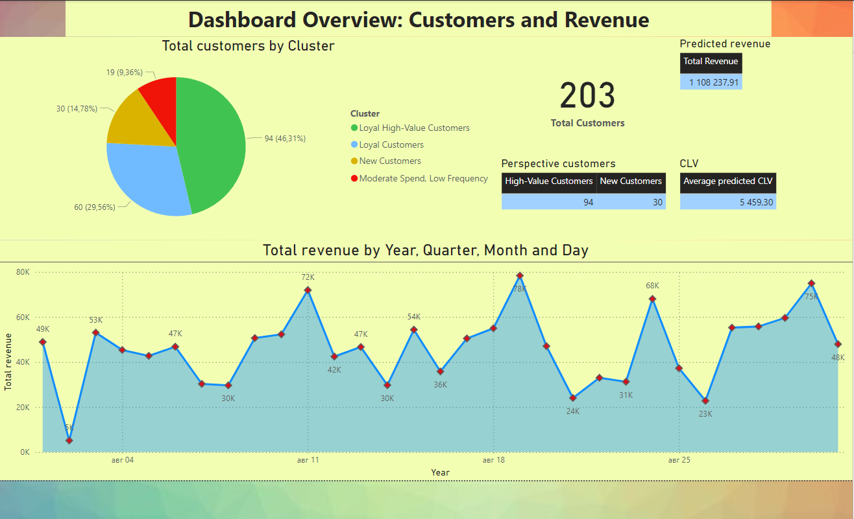

Slide 13
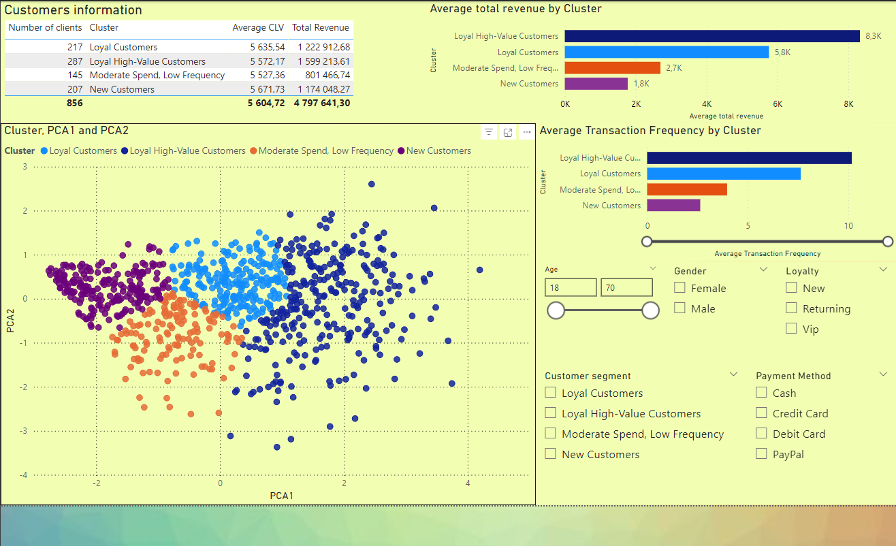

Slide 14
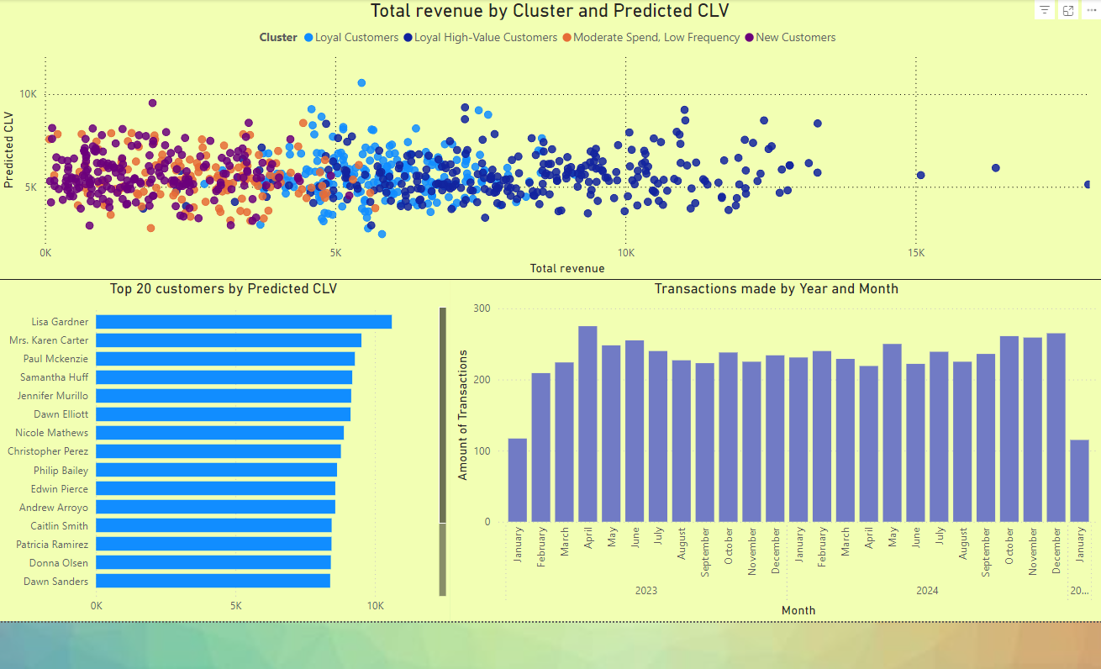

Slide 15
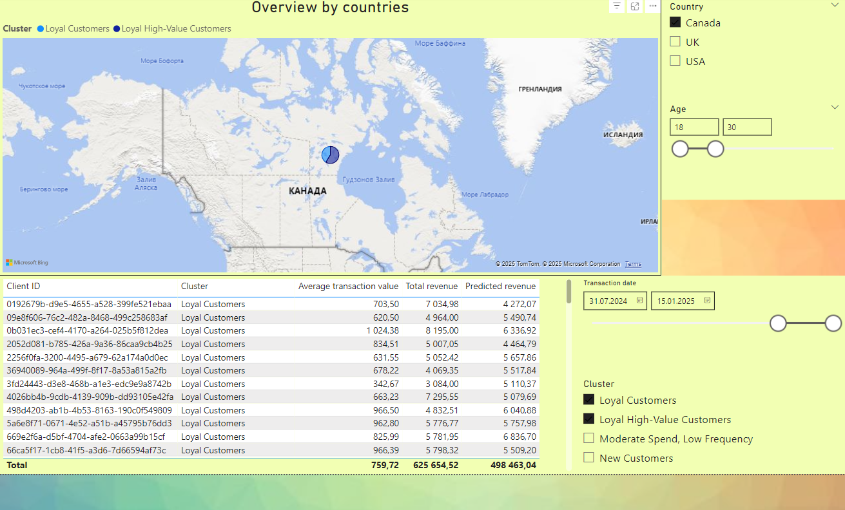

Slide 16
Insights and Recommendations
The main revenue comes from low-priced products (consumables) sold in large quantities.
Need to focus on promoting these products, bundles and discounts to push more customers to buy them.
Most customers make inexpensive purchases, regardless of frequency, and only a small portion of customers generate the bulk of revenue.
Therefore, it is necessary to identify the most loyal customers, with the highest average cost per transaction, and focus marketing efforts on them.
The frequency of purchases directly affects customer engagement. from EDA we see that there is a large portion of customers who have made 5 or fewer purchases over the entire period, and these are the customers who form the churn. It can be at-risk or new customers, but they are also very important to build a strong loyal customers base. Such customers need to be regained through the e-mail, phone, adv campaigns, or discounts.
By seeing the division of customers into segments, you can see the relationship between purchase regularity, frequency and income. High-risk and new clients require more attention. Offer introductory deals to build loyalty.
Loyal, highly profitable customers who make purchases regularly generate 80% of all income. It is important to track the behavior of such customers, what products they choose, where they live, their age, gender, and how much potential income they can bring. It is necessary to work out a marketing campaign to work with such clients, and based on its results, using a prediction model, find out the expected income from these clients.
Over the long term, by adding real-time data to the model, you can accurately predict customer behavior and the results of marketing campaigns.

Slide 17
Roadmap
Incorporating Loyalty Data
Churn Prediction
Cross-Sell/Upsell Opportunities
Real-Time Dashboards for CLV tracking

Slide 18
Links
Github
Video
Portfolio
Linkedin
CV

